Slide 1


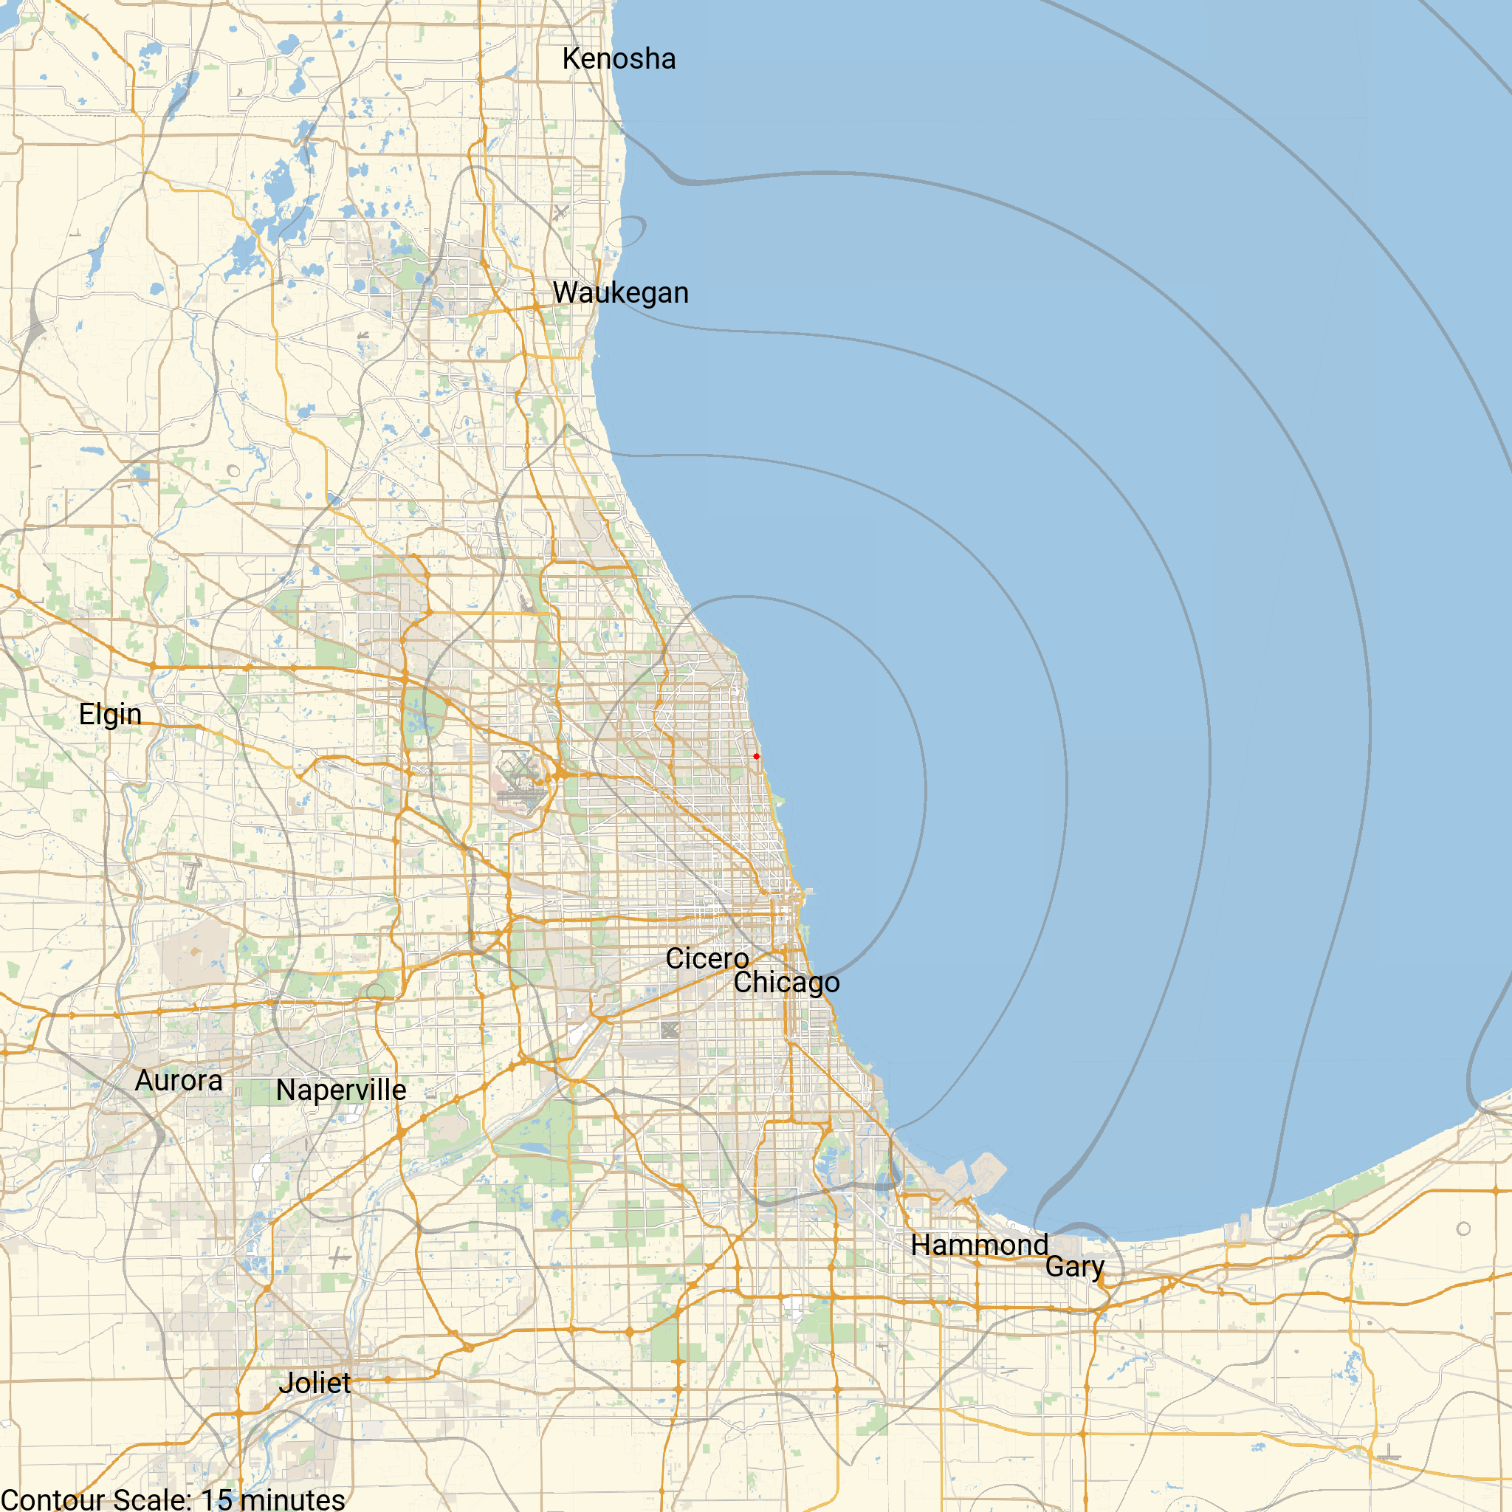
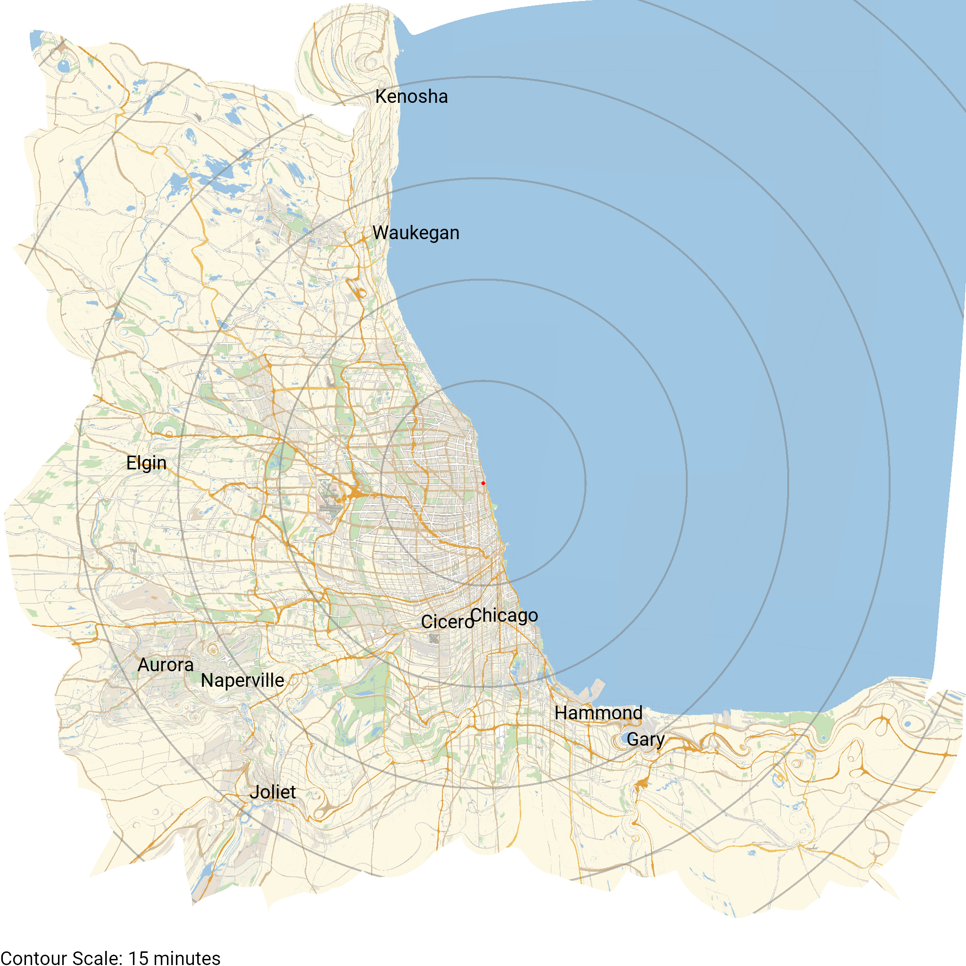
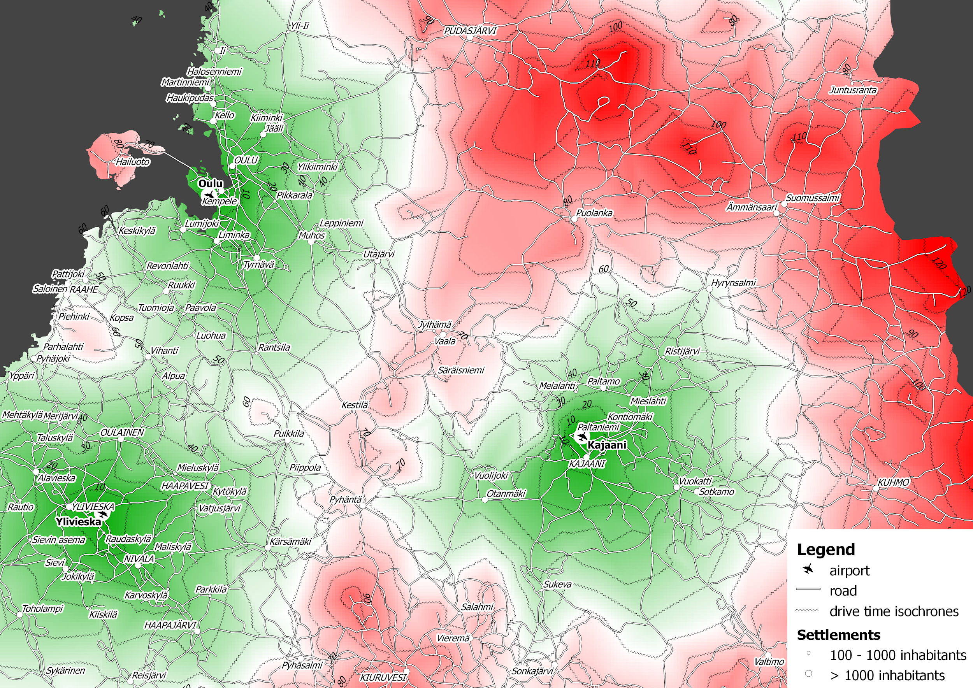
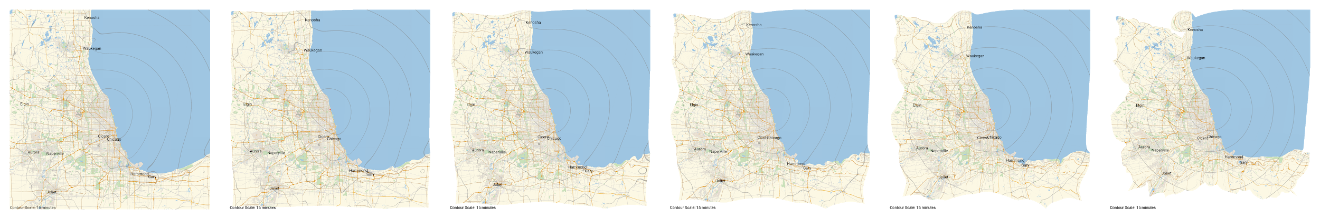
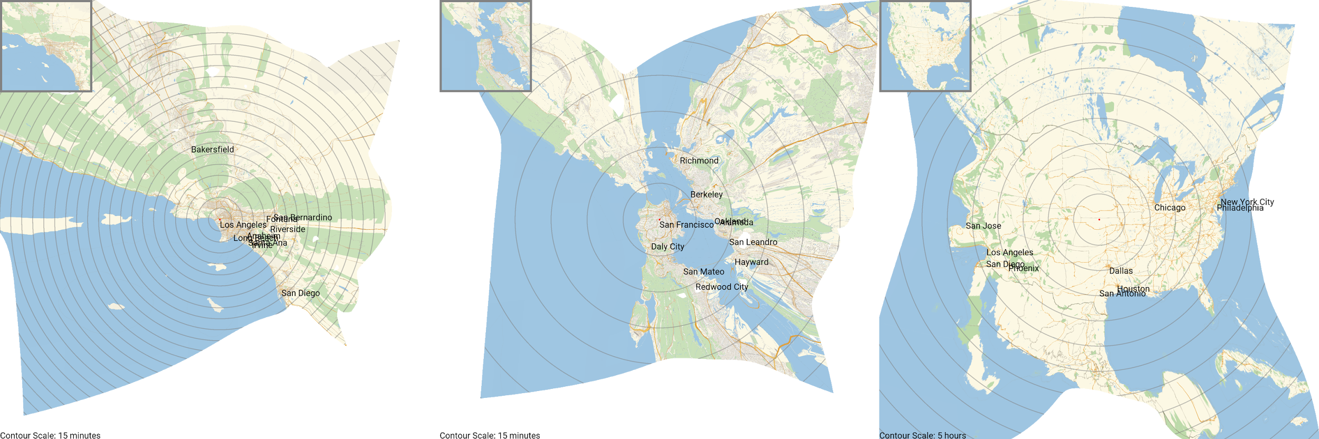


A Temporal Distance Map for
Determining Travel Time
Blake Albert, Christian Panici, Nigel Castelino
Department of Computer Science, Loyola University Chicago
Scan the QR code
to watch the full animation
of Chicago being transformed
Abstract
Some map projections preserve distance to create a physical representation of a given area; however, people are generally more concerned with the time it takes to reach a destination rather than their physical distance to it. Currently, isochrone maps can display travel times, but they are only an overlay over the original map rather than a transformation. We use Python along with travel time data from Wolfram Language to transform a map that preserves distance into one that proportionately displays locations based on the time it takes to travel there from a given point. Our map allows for different analyses on the efficiency of travel in different areas. To the best of our knowledge, this is a unique method of generating a map that gives a possibly more compelling visualization of travel time when compared to isochrone maps.
Background
What is an isochrone map?
An isochrone map displays areas in different colors to show how long it takes to get to one or more places from another.
Why is our map better?
Our method transforms the physical representation of the map so that one can truly visualize how travel time differs between certain places.
People are generally more concerned with the time it takes to get to where they want to go, and our map allows them to see that at a glance.
Method
Pick a center point and map size
Create a grid of points on the map of this area
Determine the travel time to each point from the center
Move the points away from the center relative to their travel time
Use the resulting mesh to transform the original image of the map
Overlay contours, place names, and contour scale
Impact
Assists people in determining the travel times to different places
Allows new analysis of travel patterns
Provides cities/realtors with a new way to inform people of travel times
Notice the pinching of the border around highways.
Untransformed Chicago Map
A map of Chicago with contours centered around Loyola
Each contour encloses an area that is reachable within a certain amount of time in increments of 15 minutes.
Transformed Chicago Map
A map of Chicago transformed to display locations
proportionately based on travel time from Loyola
The same 15-minute scale as the untransformed map is used, but now all places that take equally as long to reach are equidistant from the center point.
Isochrone Map
An example of an isochrone
map for airports in northern Finland created using GIS software (2011)
Each color corresponds to the amount
of time it takes to reach the nearest airport from a given point.
Animation Frames
Frame-by-frame depiction of the transformation of Chicago
The contours slowly align into concentric circles to establish a consistent scale.
Scan the QR code in the upper-right corner of this poster to watch the full animation.
Transformed Maps of Various Places
Transformed versions of Los Angeles, San Francisco, and the contiguous United States of America
Each area has its own unique travel challenges that the transformed map helps to visualize.

Slide 2
Colors for poster (from map):
#ff0000 RREDDD
#ecd1c6 rose gold
#dab56e highway
#edd7b4 freeway*
#ccddbb park*
#9ec5e2 blue water*
#8fa2b0 blue steel
#aba6a2 rock
#828282 bold rock
#e0d9d3 silver
#ede4d3 tortilla bold
#fdf8e4 tortilla
#000000 BLACK

